Slide 1
Road Safety Data-Accidents & Vehicles
Rubhan Antony Xavier Raj

Slide 2
Approach
It is very clear that it is a Non-linear Classification Problem.
The accident severity probability values in the dataset are Slight - 1.134%, Serious - 14.131%, Fatal - 84.735% and this has been predominantly reflected in the classification model as well. This is due to the fact that Fatal incidents are reported more than normal accidents.
To build a high performance Classifier, I have used the Random Forest Classifier.
I have combined the past 3 years Accidents Data for designing this model.
I have dropped features like 'LSOA_of_Accident_Location', 'Local_Authority_(Highway)', '1st_Road_Number', '2nd_Road_Number', 'Local_Authority_(District)', as they have very less significance.
I have converted Time data into Integer, which is the time count from Epoch (time origin). So, this is a linear data and is vital to the model.
The ‘NaN’ and ‘–1’ values have been replaced by ‘mean or most_frequent’ values in the column using and Imputer class code which can convert these values.
Categorical values have been OneHotEncoded (Converted to many columns of binary values for proper classification).
Techniques like Feature Scaling have been applied to increase efficiency.
Thus, the model has a classification efficiency of 82%

Slide 3
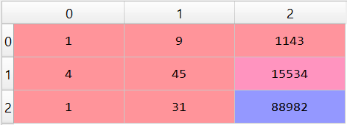
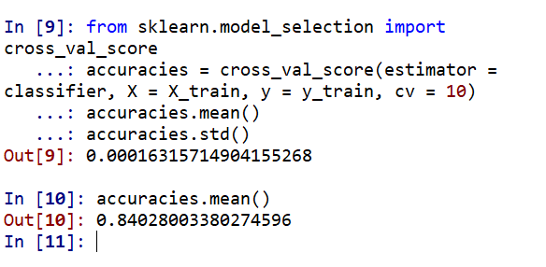
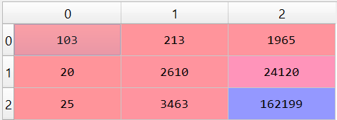
Adding Vehicles Data
Adding more features can always increase the efficiency of the model.
The main problem with the vehicles dataset is that it has repeated records for Accident_Index representing both the accident causing parties (Vehicle_Reference) and so to overcome this problem, I have used outer join to combine both Accidents and Vehicles Dataset, which has increased the dataset size.
I have dropped insignificant features in this Vehicles dataset as well.
Using the same approach as before, I achieved an increased efficiency of 85%, by adding new information.
I have validated the results by using k-fold cross validation method (fig.2)
Corresponding Confusion Matrix showing the increased accuracy in the diagonal is shown in the fig.1 & fig.3.
I have used Grid search method to find the optimal parameters for the model.
Fig1. Confusion Matrix before adding Vehicles Data
Fig2. K-fold cross validation results
Fig3.Confusion Matrix after adding Vehicles Data

Slide 4
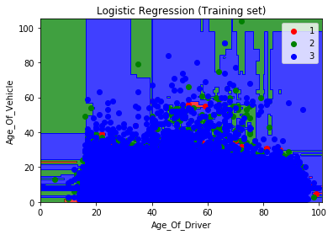
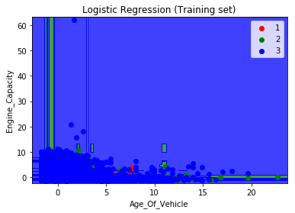
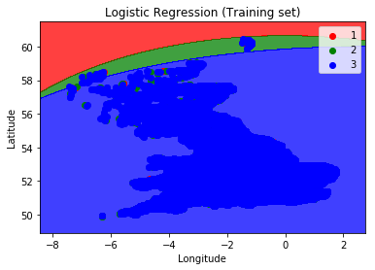
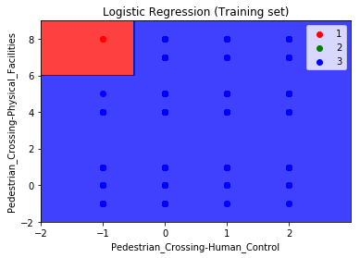
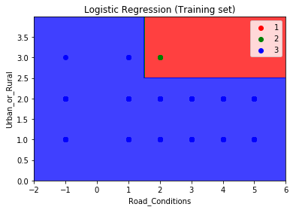
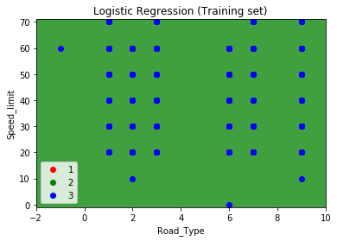
Graphs
Fig.1
Fig.2
Fig.3
Fig.4
Fig.5
Fig.6

Slide 5
Summary
The Insurance company must create more Life Insurance products for middle aged people (40-70 years) as they have more probability of Fatal accidents and must charge more premium for this category and Reserves should be maintained accordingly. (fig.1)
New vehicles are more prone to fatal accidents - so company must sell more Motor Insurance products to new vehicles and charge more premium. More Claims can be expected from them (fig.2)
People in the southern part of the UK are more prone to Accidents, so more premium must be charged in this area as well.(fig.3)
Pedestrian crossings with High physical facilities are less prone to accident. So areas with no proper pedestrian crossing must be taken into account while modelling products (fig.4)
When Road conditions are good, accidents are less. So, new insurance products for Risky road Journeys can be created(fig.5)
Urban areas have more Fatal accidents than rural areas, so more premiums must be charged in urban areas.(fig.5)

